Slide 1

OPERATING SYSTEMS
SCHEDULING

Slide 2
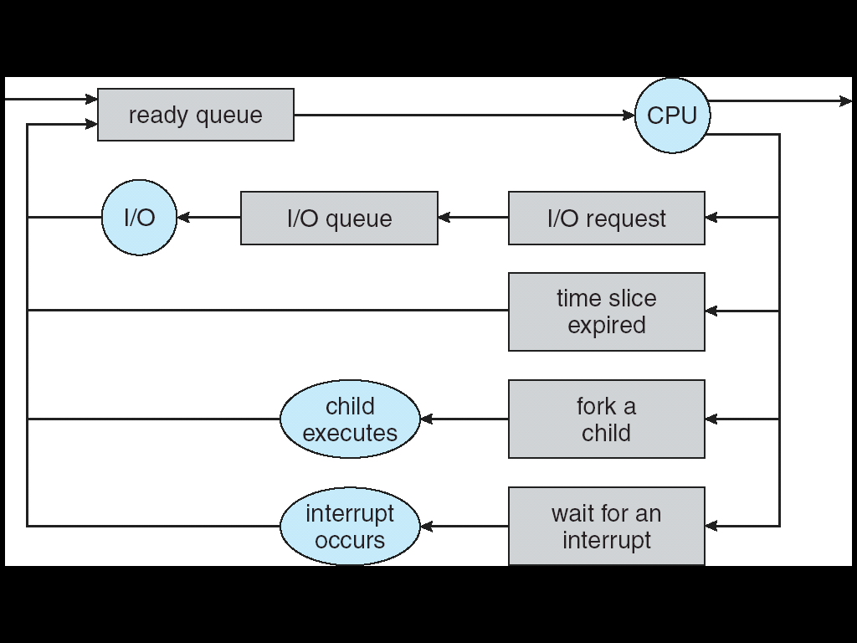
Earlier, we talked about the life-cycle of a thread
Active threads work their way from Ready queue to Running to various waiting queues.
Question: How is the OS to decide which of several threads to take off a queue?
Obvious queue to worry about is ready queue
Others can be scheduled as well, however
Scheduling: deciding which threads are given access to resources

Slide 3

CPU SCHEDULING
CPU scheduling is a process that allows one process to use the CPU while the execution of another process is on hold(in waiting state) due to unavailability of any resource like I/O etc, thereby making full use of CPU.
The aim of CPU scheduling is to make the system efficient, fast, and fair. Whenever the CPU becomes idle, the operating system must select one of the processes in the ready queue to be executed.
The selection process is carried out by the short-term scheduler (or CPU scheduler). The scheduler selects from among the processes in memory that are ready to execute and allocates the CPU to one of them.

Slide 4
CPU SCHEDULING CONCEPTS
Multiprogramming A number of programs can be in memory at the same time. Allows overlap of CPU and I/O.
Jobs (batch) are programs that run without user interaction.
User (time shared) are programs that may have user interaction.
Process is the common name for both.
CPU - I/O burst cycle Characterizes process execution, which alternates, between CPU and I/O activity. CPU times are generally much shorter than I/O times.
Preemptive Scheduling An interrupt causes currently running process to give up the CPU and be replaced by another process.
4

Slide 5
CPU-Scheduling (with multiprograming)
In a single processor system, only one process can run at a time. Others must wait until CPU is free and can be rescheduled.
Whenever the CPU becomes idle, the operating system must select one of the processes in the ready queue to be executed (the records in the queues are generally PCBs of the pocesses).
The short term scheduler (or CPU scheduler- a part of OS) selects a process to get the processor (CPU) among the processes which are already in memory. (i.e. from the ready queue).
Processor scheduling algorithms try to answer the following crucial question.
Which process in the ready queue will get the processor?
In order to answer this, one should consider the relative importance of several performance criteria.

Slide 6
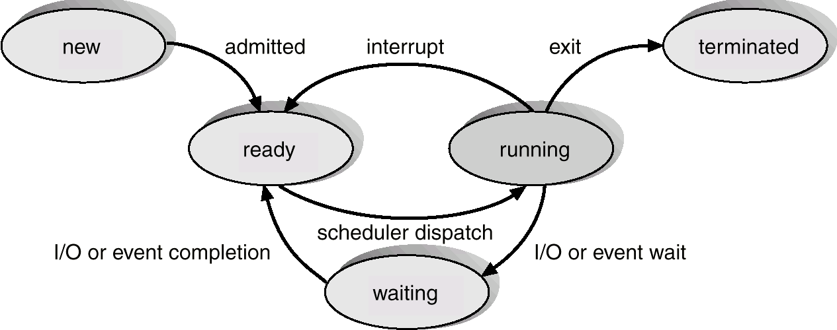
CPU Scheduler
CPU scheduler selects from the processes in memory that are ready to execute, and allocates the CPU to one of them.
CPU scheduling decisions may take place when a process:
1.Switches from running to waiting state.
2.Switches from running to ready state.
3.Switches from waiting to ready.
4.Terminates.
5.A new process joins the ready queue
2
4
5
1
3

Slide 7
Preemptive – Nonpreemptive Scheduling
5
2
4
Interrupt: Scheduler picks another process
Scheduler dispatch: Scheduler picks this process to execute
3
1
In (1) and (4), a new process must be selected from the ready queue.
In (2), (3) and (5), previously running process or a new process may be selected.
Scheduling algorithms that act only in circumstances (1) and (4) are called nonpreemptive(or cooperative). Once CPU has been allocated to a process, that process keeps the CPU until it releases the CPU (either by termination or by requesting I/O). This scheduling method was used by Microsoft Windows 3.x.
Otherwise it is preemptive. Windows 95 and all subsequent versions of Windows operating systems have used preemptive scheduling.

Slide 8
Preemptive – Nonpreemptive Scheduling
A scheduling algorithm which acts on all circumstances is called preemptive. (i.e. such an algorithm can select a new process in circumstances 2, 3 and 5).
The CPU is allocated to the highest-priority process among all ready processes. The scheduler is called each time a process enters the ready state.
Advantages of non-preemptive scheduling algorithms:
They cannot lead the system to a race condition.
They are simple.
Disadvantage of non-preemptive scheduling algorithms:
They do not allow real multiprogramming.
Advantage of preemptive scheduling algorithms:
They allow real multiprogramming.
Disadvantages of preemptive scheduling algorithms:
They can lead the system to a race condition.

Slide 9
Dispatcher
Dispatcher module (invoked during every process switch) gives control of the CPU to the process selected by the short-term scheduler; this involves:
switching context
switching to user mode
jumping to the proper location in the user program to restart that program
Dispatch latency – time it takes for the dispatcher to stop one process and start another running.

Slide 10
Context Switch
Switching the CPU to another process requires performing a state save of the current process and a state restore of a different process. This task is known as a context switch. When a context switch occurs, the kernel saves the context of the old process in its PCB and loads the saved context of the new process scheduled to run.
Context-switch speed varies from machine to machine, depending on the memory speed, the number of registers that must be copied, and the existence of special instructions (such as a single instruction to load or store all registers).

Slide 11
Scheduling Criteria
CPU utilization - keep the CPU as busy as possible. It is defined as:
(processor busy time) / (processor busy time + processor idle time)
Throughput – # of processes that complete their execution per time unit.
Turnaround time – The interval from the time of submission to the time of completion of a process.
Waiting time – amount of time a process has been waiting in the ready queue (waiting for I/O device is not counted)
Response time – amount of time it takes from when a request was submitted until the first response is produced, not output.

Slide 12
Scheduling Policy Goals/Criteria
Minimize Response Time
Minimize elapsed time to do an operation (or job)
Maximize Throughput
Two parts to maximizing throughput
Minimize overhead (for example, context-switching)
Efficient use of resources (CPU, disk, memory, etc)
Fairness
Share CPU among users in some equitable way
Fairness is not minimizing average response time:
Better average response time by making system less fair
Notes:
What does CPU scheduling have to do with efficient use of the disk?
A lot! Have to have the CPU to make a disk request
Fairness: Minimize # of angry phone calls? Minimize my response time?

Slide 13
CPU Scheduling Algorithms
First- Come, First-Served (FCFS) - Non preemptive
Shortest-Job-First (SJF) - Non preemptive
Shortest-Remaining-Time-First (SRTF) - Preemptive
Priority Scheduling - Non preemptive, Preemptive
Round Robin (RR) - Preemptive
Priority – RR (Multilevel Queue Scheduling, Multilevel Feedback Queue Scheduling)

Slide 14
First-Come, First-Served (FCFS) Scheduling
First-Come, First-Served (FCFS)
Also “First In, First Out” (FIFO) or “Run until done”
In early systems, FCFS meant one program scheduled until done (including I/O)
Now, means keep CPU until thread blocks
Example: Process Burst Time P₁ 24 P₂ 3 P₃ 3
Suppose processes arrive in the order: P₁ , P₂ , P₃ The Gantt Chart for the schedule is:
Waiting time for P₁ = 0; P₂ = 24; P₃ = 27
Average waiting time: (0 + 24 + 27)/3 = 17
Average completion time: (24 + 27 + 30)/3 = 27
Convoy effect: short process behind long process
P₁
P₂
P₃
0
24
27
30

Slide 15
FCFS Scheduling (Cont.)
Example continued:
Suppose that processes arrive in order: P₂ , P₃ , P₁ Now, the Gantt chart for the schedule is:
Waiting time for P₁ = 6; P₂ = 0; P₃ = 3
Average waiting time: (6 + 0 + 3)/3 = 3
Average Completion time: (3 + 6 + 30)/3 = 13
In second case:
Average waiting time is much better (before it was 17)
Average completion time is better (before it was 27)
FCFS Pros and Cons:
Simple (+)
Short jobs get stuck behind long ones (-)
Safeway: Getting milk, always stuck behind cart full of small items
P₂
P₃
P₁
0
3
6
30

Slide 16
Shortest-Job-First (SJF) Scheduling
Associate with each process the length of its next CPU burst. Use these lengths to schedule the process with the shortest next CPU burst time. If the next CPU bursts of two processes are the same, FCFS scheduling is used to break the tie.
Two versions:
nonpreemptive – once CPU given to the process it cannot be preempted until completes its CPU burst.
preemptive – if a new process arrives with CPU burst length less than remaining time of current executing process, then preempt the current one. This scheme is known as Shortest-Remaining-Time-First (SRTF).
SJF is optimal – gives minimum average waiting time for a given set of processes.
The main problem with the SJF algorithm is to know for each process the next CPU burst time!!! However some techniques exist to predict this next CPU burst time (could ask to the user).
Another problem is that starvation of long processes may occur.

Slide 17
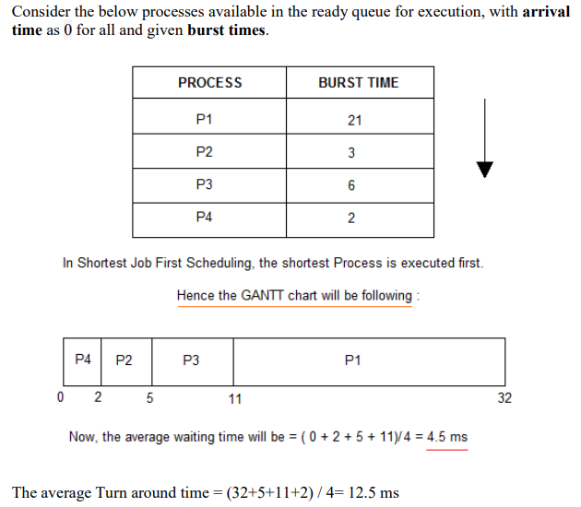
Non Pre-emptive Shortest Job First

Slide 18
Problem with Non Pre-emptive SJF
If the arrival time for processes are different, which means all the processes are not available in the ready queue at time 0, and some jobs arrive after some time, in such situation, sometimes process with short burst time have to wait for the current process's execution to finish, because in Non Pre-emptive SJF, on arrival of a process with short duration, the existing job/process's execution is not halted/stopped to execute the short job first.
This leads to the problem of Starvation, where a shorter process has to wait for a long time until the current longer process gets executed. This happens if shorter jobs keep coming, but this can be solved using the concept of aging.

Slide 19
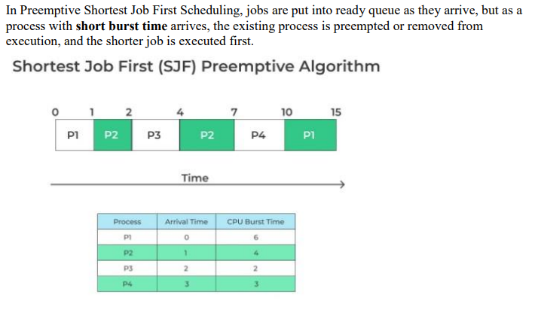
Pre-emptive Shortest Job First

Slide 20
At ( t =0ms ), P1 arrives. It’s the only process so CPU starts executing it.
At ( t = 1ms ), P2 has arrived . At this time, P1 (remaining time ) = 5 ms . P2 has 4ms , so as P2 is shorter, P1 is preempted and P2 process starts executing.
At ( t = 2ms ), P3 process has arrived. At this time, P1(remaining time) = 5ms, P2(remaining time ) = 3 ms , P3 = 2ms. Since P3 is having least burst time, P3 is executed .
At ( t = 3ms ), P4 comes , At this time, P1 = 5ms, P2 = 3ms, P3 = 1ms, P4 = 3ms. Since P4 does not have short burst time, so P3 continues to execute.
At ( t= 4ms ),P3 is finished . Now, remaining tasks are P1 = 5ms, P2 = 3ms, P4 = 3ms. As ,P2 and P4 have same time, so the task which came first will be executed first. So, P2 gets executed first.
At ( t = 7ms ),P4 gets executed for 3ms.
At ( t = 10ms ), P1 gets executed till it finishes.
Turn around time= Completion time – Arrival Time
P1 = (15-0) = 15ms P2 = (7-1) = 6ms P3 = (4-2 )=2ms P4 = (10-3)= 7ms
The average Turn around time is ( 15 +6 + 2 + 7)/4 = 30/4 = 7.5
Waiting time = Turn around time – Burst Time
P1 waiting time = (15-6) = 9ms P2 waiting time = (6-4) = 2ms P3 waiting time = (2-2 )=0ms P4 waiting time = (7-3)= 4ms
The average waiting time is ( 9 +2 + 0 + 4)/4 = 15/4 = 3.75

Slide 21
Priority Scheduling
A priority number (integer) is associated with each process
The CPU is allocated to the process with the highest priority ((smallest or largest integer value may be defined as the highest priority)
Preemptive
Nonpreemptive
SJF is priority scheduling where priority is the inverse of predicted next CPU burst time
Problem ≡ Starvation – low priority processes may never execute
Solution ≡ Aging – as time progresses increase the priority of the process

Slide 22
Example - Priority Scheduling
Process | Arrival time | CPU burst time | Priority
A | 0 | 100 | 3
B | 0 | 10 | 1
C | 0 | 300 | 3
D | 0 | 60 | 5
E | 80 | 150 | 4
5 highest
1 lowest
Non-preemptive priority Algorithm:
D | A | E | C | B
0 60 160 310 610 620
W (A) = 60ms, W (B) = 610ms, W (C) = 310ms, W (D) = 0 ms, W (E) = 80ms
Preemptive priority Algorithm (if a job come with high priority there is a switching):
D | A | E | A | C | B
0 60 80 230 310 610 620
W(A) = 210 ms, W(B) = 610 ms, W(C) = 310 ms, W(D)=0ms, Wait (E) = 0 ms

Slide 23





Example - Priority Scheduling
ProcessA arri Burst TimeT Priority
P₁ 10 3
P₂ 1 1 (highest)
P₃ 2 4
P₄ 1 5
P₅ 5 2
Priority scheduling Gantt Chart
Average waiting time = 8.2 msec

Slide 24
Round Robin Scheduling
Round Robin(RR) scheduling algorithm is mainly designed for time-sharing systems. This algorithm is similar to FCFS scheduling, but in Round Robin(RR) scheduling, preemption is added which enables the system to switch between processes.
A fixed time is allotted to each process, called a quantum, for execution.
Once a process is executed for the given time period that process is preempted and another process executes for the given time period.
Context switching is used to save states of preempted processes.
This algorithm is simple and easy to implement and the most important is thing is this algorithm is starvation-free as all processes get a fair share of CPU.
It is important to note here that the length of time quantum is generally from 10 to 100 milliseconds in length.

Slide 25
Important characteristics of the Round Robin(RR) Algorithm
1. Round Robin Scheduling algorithm resides under the category of Preemptive Algorithms.
2. This algorithm is one of the oldest, easiest, and fairest algorithm.
3. This Algorithm is a real-time algorithm because it responds to the event within a specific time limit.
4. In this algorithm, the time slice should be the minimum that is assigned to a specific task that needs to be processed. Though it may vary for different operating systems.
5. This is a hybrid model and is clock-driven in nature.
6. This is a widely used scheduling method in the traditional operating system.

Slide 26
Important Terms of Round Robin Scheduling
1. Completion Time It is the time at which any process completes its execution.
2. Turn Around Time This mainly indicates the time Difference between completion time and arrival time. The Formula to calculate the same is:
Turn Around Time = Completion Time – Arrival Time
3. Waiting Time(W.T): It Indicates the time Difference between turn around time and burst time. And is calculated as
Waiting Time = Turn Around Time – Burst Time

Slide 27
Example of RR with Time Quantum = 20
Example: Process Burst Time Remaining Time P₁ 53 53 P₂ 8 8 P₃ 68 68 P₄ 24 24
The Gantt chart is:

Slide 28
Example of RR with Time Quantum = 20
Example: Process Burst Time Remaining Time P₁ 53 33 P₂ 8 8 P₃ 68 68 P₄ 24 24
The Gantt chart is:
P₁
0
20

Slide 29
Example of RR with Time Quantum = 20
Example: Process Burst Time Remaining Time P₁ 53 33 P₂ 8 0 P₃ 68 68 P₄ 24 24
The Gantt chart is:
P₁
P₂
0
20
28

Slide 30
Example of RR with Time Quantum = 20
Example: Process Burst Time Remaining Time P₁ 53 33 P₂ 8 0 P₃ 68 48 P₄ 24 24
The Gantt chart is:
P₁
P₂
P₃
0
20
28
48

Slide 31
Example of RR with Time Quantum = 20
Example: Process Burst Time Remaining Time P₁ 53 33 P₂ 8 0 P₃ 68 48 P₄ 24 4
The Gantt chart is:
P₁
P₂
P₃
P₄
0
20
28
48
68

Slide 32
Example of RR with Time Quantum = 20
Example: Process Burst Time Remaining Time P₁ 53 13 P₂ 8 0 P₃ 68 48 P₄ 24 4
The Gantt chart is:
P₁
P₂
P₃
P₄
P₁
0
20
28
48
68
88

Slide 33
Example of RR with Time Quantum = 20
Example: Process Burst Time Remaining Time P₁ 53 13 P₂ 8 0 P₃ 68 28 P₄ 24 4
The Gantt chart is:
P₁
P₂
P₃
P₄
P₁
P₃
0
20
28
48
68
88
108

Slide 34
Example of RR with Time Quantum = 20
Example: Process Burst Time Remaining Time P₁ 53 0 P₂ 8 0 P₃ 68 0 P₄ 24 0
The Gantt chart is:
Waiting time for P₁=(68-20)+(112-88)=72 P₂=(20-0)=20 P₃=(28-0)+(88-48)+(125-108)=85 P₄=(48-0)+(108-68)=88
Average waiting time = (72+20+85+88)/4=66¼
Average completion time = (125+28+153+112)/4 = 104½
Thus, Round-Robin Pros and Cons:
Better for short jobs, Fair (+)
Context-switching time adds up for long jobs (-)
P₁
P₂
P₃
P₄
P₁
P₃
P₄
P₁
P₃
P₃
0
20
28
48
68
88
108
112
125
145
153

